Slide 1
Social Media Monitoring:
Join the conversation and maximise your social presence
Lorraine Griffin

Slide 2


A litle about me..
Content Marketing expert with 15 years experience across a number of marketing and journalism roles, for companies like O2 and Bank of Ireland
My company offers 3 services:
  Content Creation
  Social Media Coaching/Lecturing
  Content Marketing & Social Media Consultancy
  Lecture at DMI and NCI
  Client base includes:
Notes:
http://www.journalism.co.uk/news/study-96-of-uk-journalists-use-social-media-each-day/s2/a554687/

Slide 3
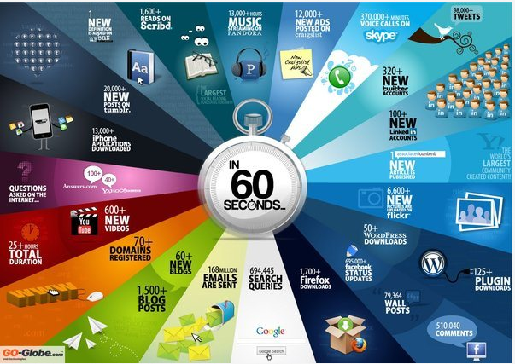
Every 60 seconds..
Notes:
http://www.journalism.co.uk/news/study-96-of-uk-journalists-use-social-media-each-day/s2/a554687/

Slide 4
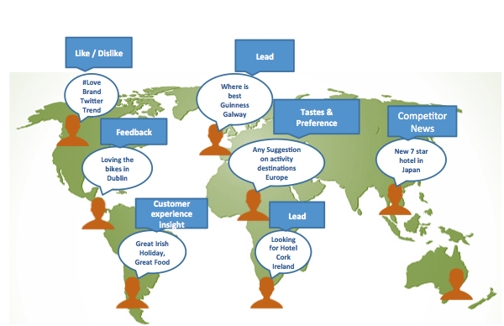
Be a part of the conversation
Social Media is about sharing, commenting, recommending, asking, praising/complaining. It’s where people communicate.
Notes:
http://www.journalism.co.uk/news/study-96-of-uk-journalists-use-social-media-each-day/s2/a554687/

Slide 5
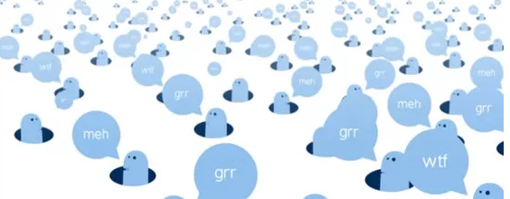
What is social media monitoring?
It is the use of tools to carry out active monitoring of social media channels for information about a company or organisation
It involves tracking online content such as blogs, news / review sites and social media sites such as Twitter, Facebook, Pinterest etc

Slide 6
What should you be tracking?
Channels: Recognise which channels are being used by your target audience. Helps to decide which ones are best suited to your brand
Tone: Understand the tone or sentiment – are consumers happy? What is the attitute to your brand?
Style: Is the commentary serious, youthful, funky, professional? This will help to adapt the content you use.
Demographic: to recognise age, gender, location, interests.
Influencers: to find out who are the leading voices for the group.
Keywords and Hashtags: related to campaign/brand/event
Listen
React
Engage
Notes:
http://www.journalism.co.uk/news/study-96-of-uk-journalists-use-social-media-each-day/s2/a554687/

Slide 7
Benefits of monitoring
Pinpoint mentions of brand and competition; understand where the conversation is taking place
Uncover trends and identify opportunities to engage
Define key influencers
Sentiment and channel breakdown
Report easily and quickly
Flag for follow up and engagement if appropriate
Get a better understanding of what content is working
Monitor trends and emerging crisis – set alerts and reports to reveal events in real time.
Notes:
http://www.journalism.co.uk/news/study-96-of-uk-journalists-use-social-media-each-day/s2/a554687/

Slide 8
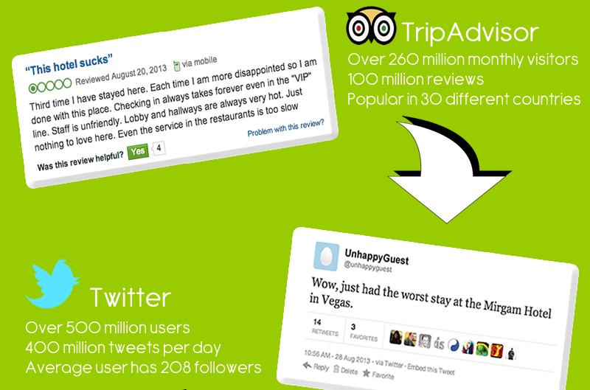
Instant feedback..that travels fast!
Notes:
http://www.journalism.co.uk/news/study-96-of-uk-journalists-use-social-media-each-day/s2/a554687/

Slide 9
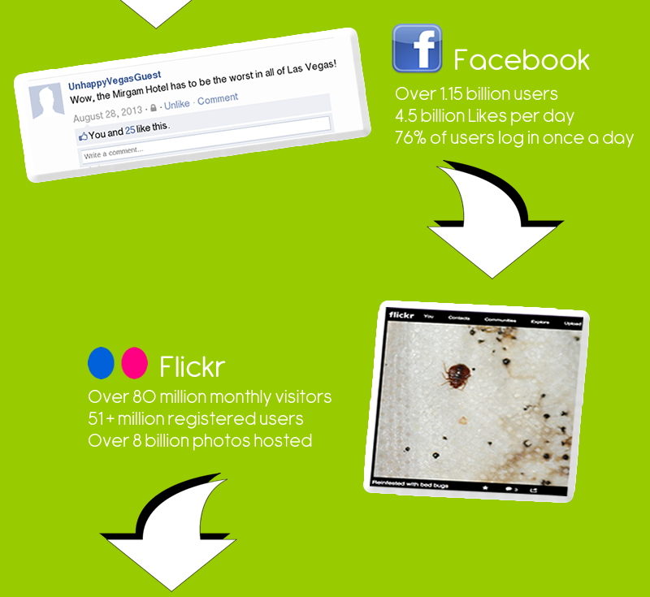
Instant feedback..that travels fast!
Notes:
http://www.journalism.co.uk/news/study-96-of-uk-journalists-use-social-media-each-day/s2/a554687/

Slide 10
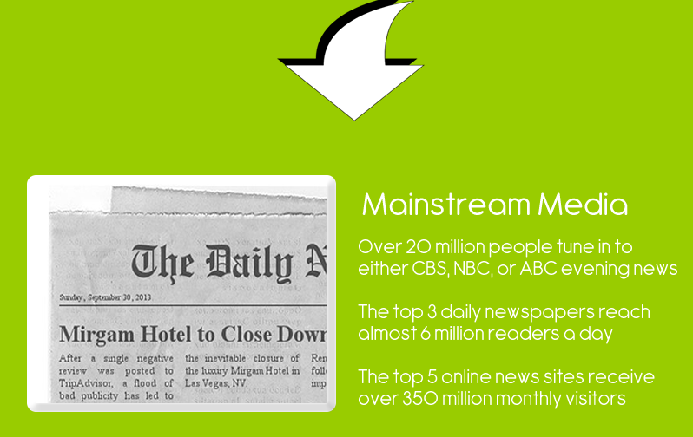
Instant feedback..that travels fast!
Notes:
http://www.journalism.co.uk/news/study-96-of-uk-journalists-use-social-media-each-day/s2/a554687/

Slide 11
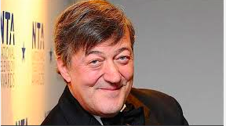
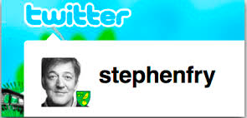


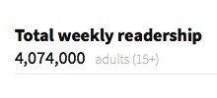
Social Media more powerful than trad media..
Notes:
http://www.journalism.co.uk/news/study-96-of-uk-journalists-use-social-media-each-day/s2/a554687/

Slide 12
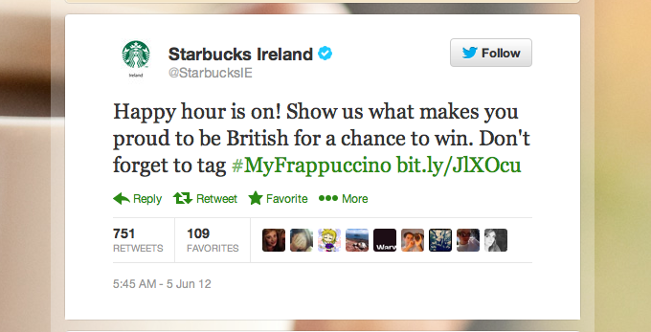
Turn the conversation around!
There are ways to turn a negative into a positive…
Notes:
http://www.journalism.co.uk/news/study-96-of-uk-journalists-use-social-media-each-day/s2/a554687/

Slide 13
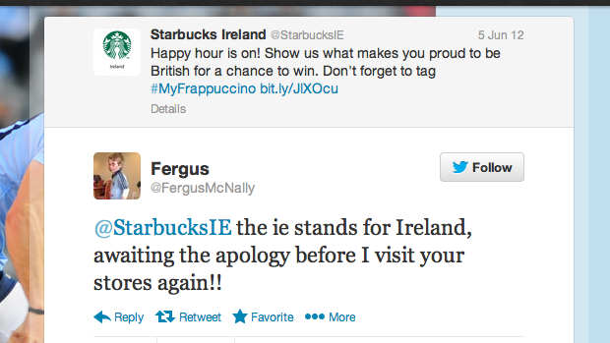
Turn the conversation around!
Notes:
http://www.journalism.co.uk/news/study-96-of-uk-journalists-use-social-media-each-day/s2/a554687/

Slide 14
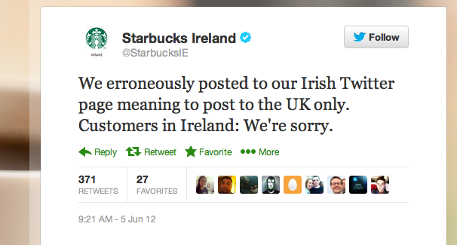
Turn the conversation around!
Notes:
http://www.journalism.co.uk/news/study-96-of-uk-journalists-use-social-media-each-day/s2/a554687/

Slide 15
How to deal with negativity online
Respond (if appropriate)
Refer to your Rules of Engagement or T&Cs
Provde ‘holding post’ until new information available
Engage with community and regularly update
Provide transparent, factually-correct information
Stay firm and vigilant
Notes:
http://www.journalism.co.uk/news/study-96-of-uk-journalists-use-social-media-each-day/s2/a554687/

Slide 16

Interacting with online audience
Respond to Feedback (Both negative and positive)
Be Proactive
Be as Transparent as Possible
Go one further. DM the user who has an issue or give a phone number or email address so the problem can be quickly solved
Don't Always Jump In
Create Brand Awareness
Engage your followers – show them the human side of your business with humour and Irishness (if appropriate) while keeping within your brand guidelines
Notes:
http://www.journalism.co.uk/news/study-96-of-uk-journalists-use-social-media-each-day/s2/a554687/

Slide 17
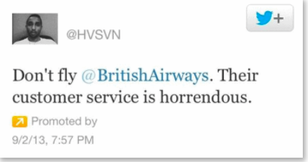
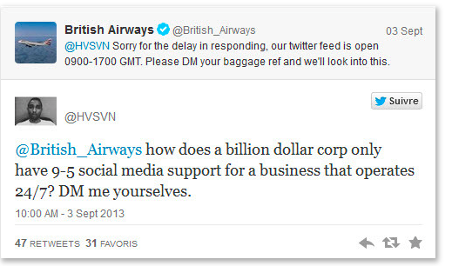
Respond quickly!
Notes:
http://www.journalism.co.uk/news/study-96-of-uk-journalists-use-social-media-each-day/s2/a554687/

Slide 18
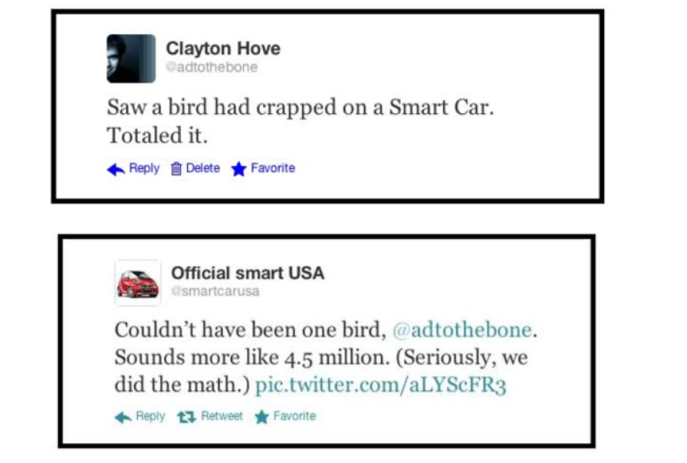
When humour works well
Notes:
http://www.journalism.co.uk/news/study-96-of-uk-journalists-use-social-media-each-day/s2/a554687/

Slide 19
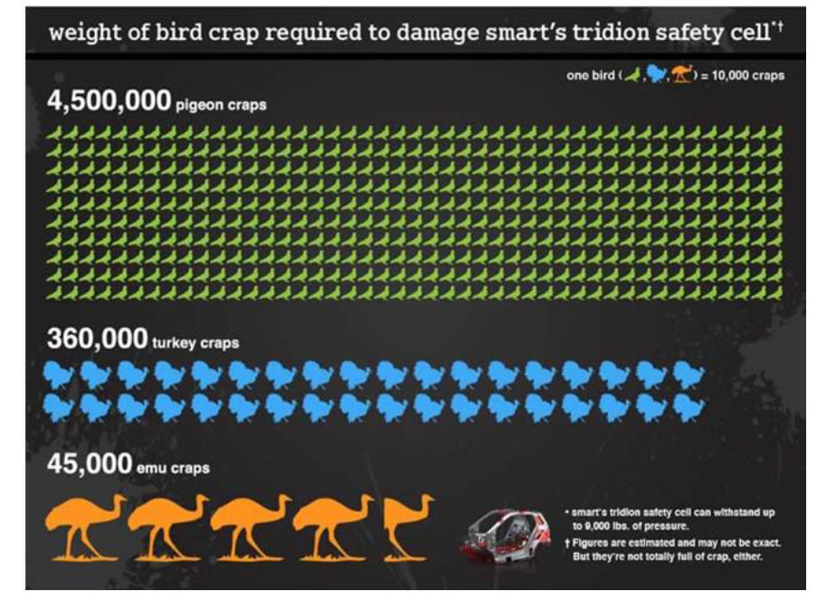
When humour works well
Notes:
http://www.journalism.co.uk/news/study-96-of-uk-journalists-use-social-media-each-day/s2/a554687/

Slide 20
Social Media
Monitoring
Tools

Slide 21


















Social Media Tools
A range of tools available suitable for SMEs or large corporates, or both.
Notes:
http://www.journalism.co.uk/news/study-96-of-uk-journalists-use-social-media-each-day/s2/a554687/

Slide 22
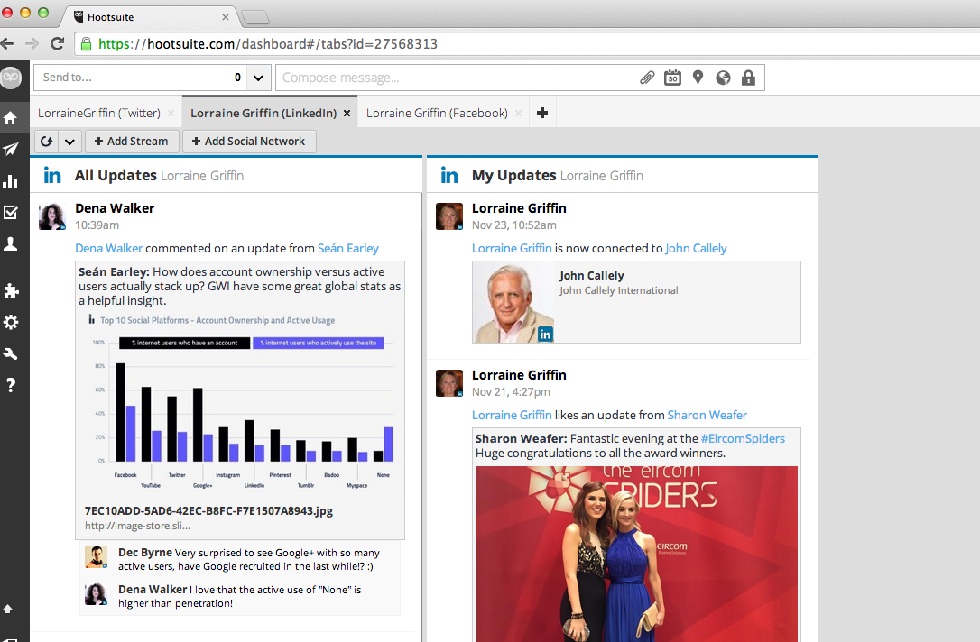
Social Media Tools -hootsuite
Notes:
http://www.journalism.co.uk/news/study-96-of-uk-journalists-use-social-media-each-day/s2/a554687/

Slide 23
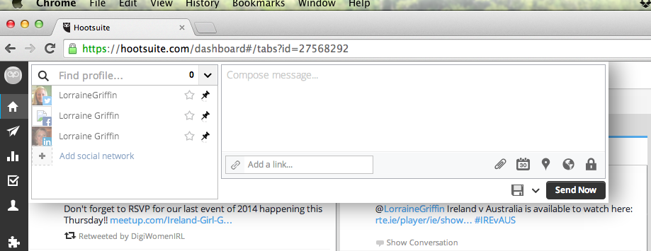
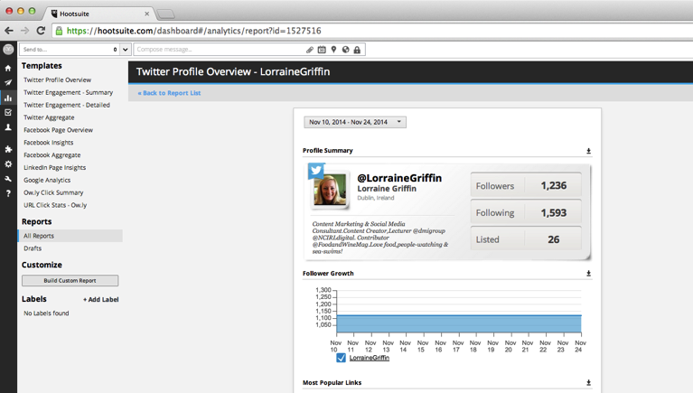
Social Media Tools- hootsuite
Cost: Free for monitoring up to 5 platforms (Facebook, Twitter)
Paid version starts at approx. €7.50 a month, Enterprise is costed per user
Notes:
http://www.journalism.co.uk/news/study-96-of-uk-journalists-use-social-media-each-day/s2/a554687/

Slide 24
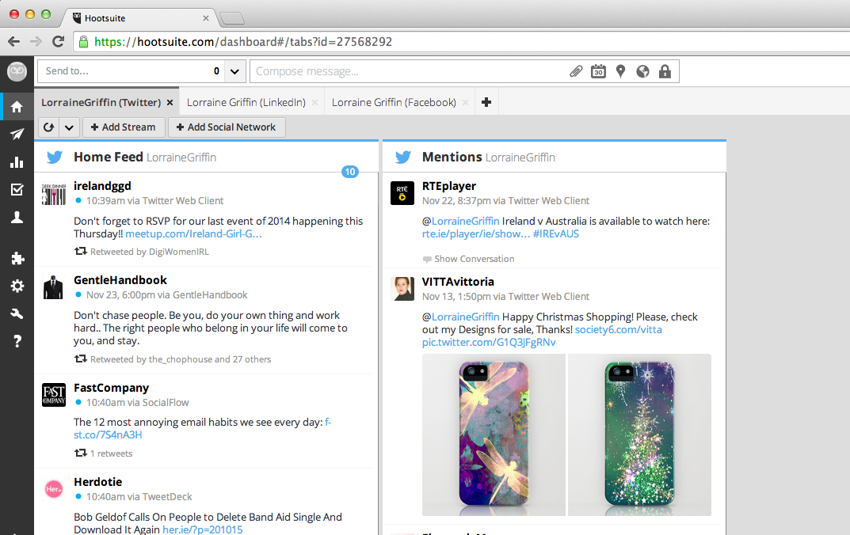
Social Media Tools -hootsuite
Notes:
http://www.journalism.co.uk/news/study-96-of-uk-journalists-use-social-media-each-day/s2/a554687/

Slide 25
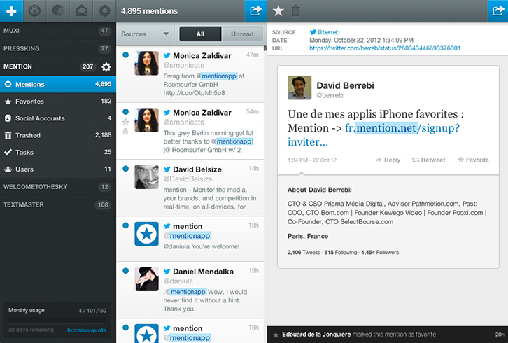
Social Media Tools –mention
Cost: Free and Paid Pro plan starts at approx €15.00 per month 50,000 mentions
Notes:
http://www.journalism.co.uk/news/study-96-of-uk-journalists-use-social-media-each-day/s2/a554687/

Slide 26
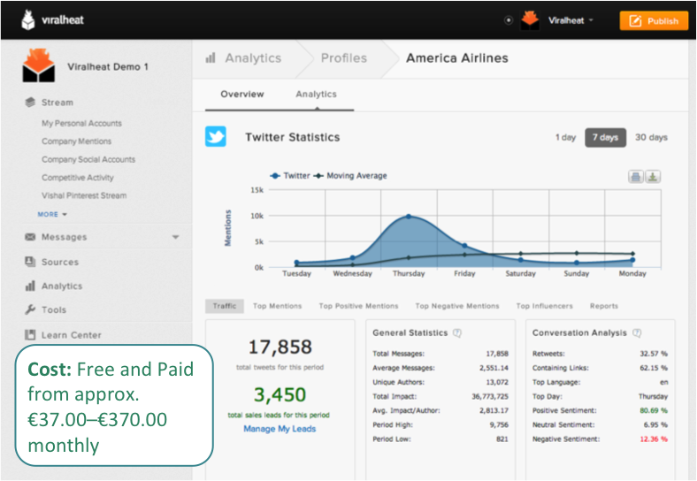
Social Media Tools –viralheat
Notes:
http://www.journalism.co.uk/news/study-96-of-uk-journalists-use-social-media-each-day/s2/a554687/

Slide 27
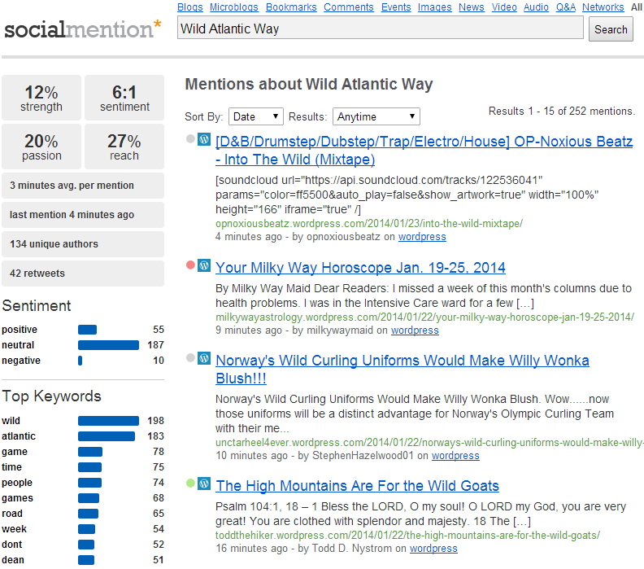
Social Media Tools –socialmention
1
Likelihood that your brand is being discussed in social media
Ratio of positive to negative Mentions
Measure of the range of influence (no of unique authors divided by total no of mentions)
Likelihood of repeat mentions
www.socialmention.com
Notes:
http://www.journalism.co.uk/news/study-96-of-uk-journalists-use-social-media-each-day/s2/a554687/

Slide 28
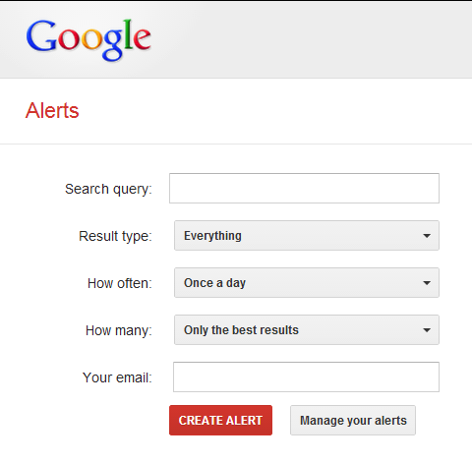
FREE TOOL – google alerts
Google Alerts are emails sent to you when Google finds new results that match your search term (e.g. web pages, newspaper articles, blogs)
You can use Google Alerts to monitor anything on the web
www.google.com/alerts
Notes:
http://www.journalism.co.uk/news/study-96-of-uk-journalists-use-social-media-each-day/s2/a554687/

Slide 29
Why pay for these tools?
In some cases, it’s worth spending money to harness all the benefits of these tools, for example:
  More detailed reports, tailored for different departments (sales, events, customer service etc)
  Deeper analysis into the audience and commentary
  Greater audience segmentation
  Additional users and admins can be added (very nb for customer service)
  Access to extra features – lead tracking, scheduling, flagging etc
http://files.pr2020.com/PR_SM-Monitoring-Comparison.pdf
Notes:
http://www.journalism.co.uk/news/study-96-of-uk-journalists-use-social-media-each-day/s2/a554687/

Slide 30


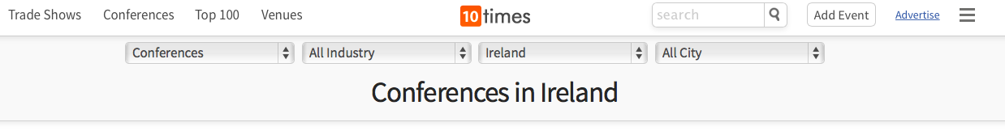



Tap into what’s happening
Notes:
http://www.journalism.co.uk/news/study-96-of-uk-journalists-use-social-media-each-day/s2/a554687/

Slide 31









Tap into calendar / seasons
Notes:
http://www.journalism.co.uk/news/study-96-of-uk-journalists-use-social-media-each-day/s2/a554687/

Slide 32
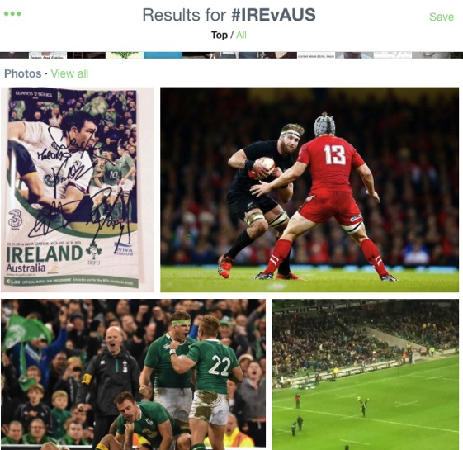
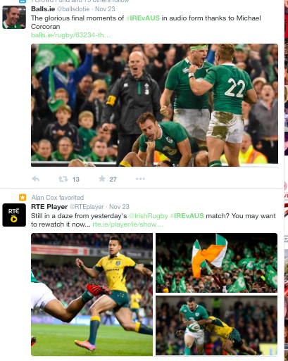
Tap into what’s trending online
Notes:
http://www.journalism.co.uk/news/study-96-of-uk-journalists-use-social-media-each-day/s2/a554687/

Slide 33
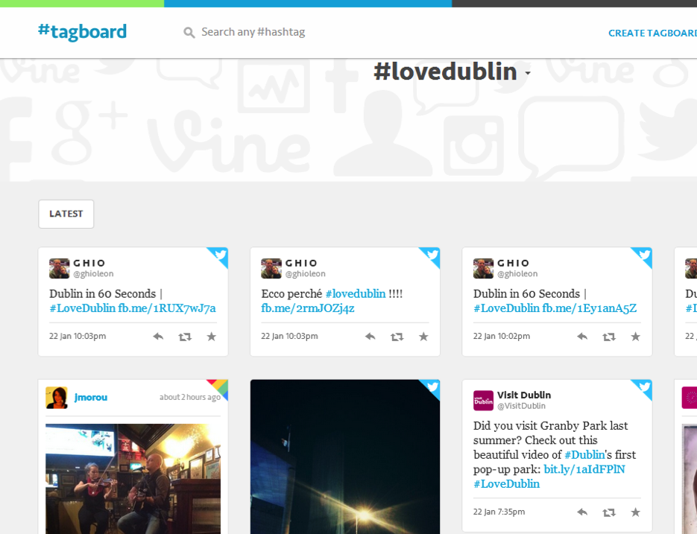
Tap into what’s trending online
Search hashtags across networks, including Twitter, Instagram, App.net and Facebook
Notes:
http://www.journalism.co.uk/news/study-96-of-uk-journalists-use-social-media-each-day/s2/a554687/

Slide 34
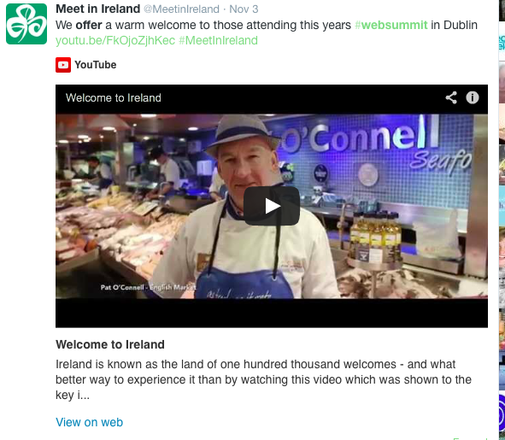
Also known as ‘Trend-jacking’
Notes:
http://www.journalism.co.uk/news/study-96-of-uk-journalists-use-social-media-each-day/s2/a554687/

Slide 35

Also known as ‘Trend-jacking’
Notes:
http://www.journalism.co.uk/news/study-96-of-uk-journalists-use-social-media-each-day/s2/a554687/

Slide 36
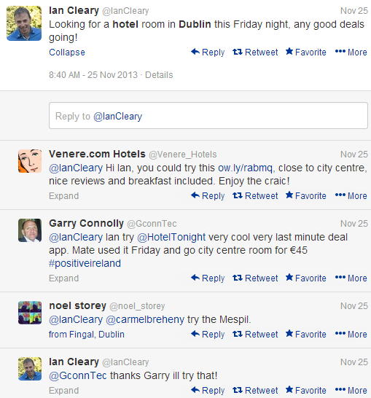
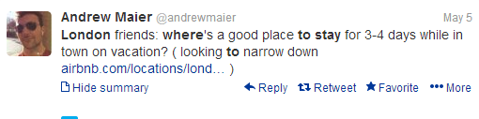
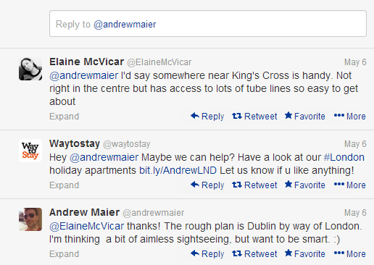
Listen for opportunities
Notes:
http://www.journalism.co.uk/news/study-96-of-uk-journalists-use-social-media-each-day/s2/a554687/

Slide 37
How often should you monitor?
Depends on your overall online strategy
Important to make it part of your regular routine to help refine your approach
Key for social media customer service platforms
Crucial during campaigns as feedback mechanism
Note: Most Monitoring tools provide notification service and in some cases push notifications thus allowing you interact or engage when it matters.
Notes:
http://www.journalism.co.uk/news/study-96-of-uk-journalists-use-social-media-each-day/s2/a554687/

Slide 38
Key Takeaways
Identify the keywords you are going to monitor
Start monitoring using at least one of the tools we mentioned today
Make it part of your daily routine to RESPOND TO EVERY MENTION
Notes:
http://www.journalism.co.uk/news/study-96-of-uk-journalists-use-social-media-each-day/s2/a554687/

Slide 39
Contact details
Website: www.lorrainegriffin.ie
Email: hello@lorrainegriffin.ie
LinkedIn: ie.linkedin.com/in/lorrainegriffin
Twitter: @lorrainegriffin
Notes:
http://www.journalism.co.uk/news/study-96-of-uk-journalists-use-social-media-each-day/s2/a554687/

