Slide 1
Google Month ‘Digital Alphabet’
week4; Tips & Resources

Slide 2
Upskill with our Digital Marketing ‘tips’ in our Digital Alphabet for Google Month 2014

Slide 3
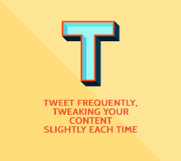
T
Tweet frequently, tweaking your content slightly to send it out at different times of the day to optimise your reach.
Text tailored to your target audience will help create the right emotions and help to put them in the frame of mind to book with you.
TripAdvisor has launched a new 'Q&A' service for users that allows hotels and other travellers to respond to their queries in a public forum.
Find out more here:
www.twitter.com
www.tripadvisor.com
http://bit.ly/1s0xmMq
http://bit.ly/1mmQtiQ

Slide 4
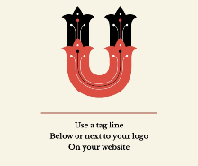
U
Use a tagline below or next to your logo to associate a memorable phrase with your brand name on your website.
Use bullet points on your landing page to list important messages and features. This will reinforce your selling points.
Utilise Instagram to reach over 200 million users, 57% of whom access the platform daily.
Find out more here:
www.instagram.com
https://support.google.com/webmasters/answer/35769

Slide 5
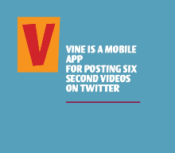
V
Vine is a mobile app owned by Twitter that enables its users to create and post short video clips (up to six seconds).
Visuals can be used, on your website, to showcase your business from all possible angles, build trust and create the right emotions in potential customers.
Vimeo is a very popular video-sharing website on which users can upload, share and view video.
Find out more here:
http://bit.ly/1s0xmMq
www.vimeo.com

Slide 6
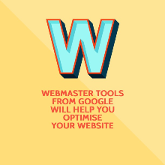
W
Webmaster Tools from Google will help you optimise your website performance.
Wordpress.com is a great blogging platform with a range of web templates to choose from.
Wordswag is a useful app for adding captions to images in a variety of stylised fonts.
Wordsalad is a handy app for creating 'word cloud' graphics.
Find out more here:
https://support.google.com/webmasters/answer/35769
www.wordpress.com
http://wordswag.co/
http://bit.ly/1zWUkbb

Slide 7
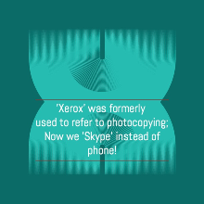
X
‘Xerox' was formerly used to refer to photocopying, now we are 'Skyping' our contacts when we want to call them online!
Find out more here:
www.skype.com

Slide 8
Y
YouTube - the video online library where you can upload your videos to & search for a wide range of videos.
YouTube gets the most web visits after Google and Facebook & every 60 seconds, 100 hours of video are uploaded to YouTube.
You should always respond to both positive and negative reviews
on TripAdvisor to maintain a consistent brand presence.
Find out more here:
www.youtube.com
www.tripadvisor.com

Slide 9
Z
Zen is the art of 'social media maintenance': post, respond, engage, measure, repurpose and measure again !
Find out more here:
http://blog.paper.li/

Slide 10
Google month
Week 4 Hangout
Meet the speaker
Join us for Week 4 of our series of ‘Google Month’ Hangouts on YouTube and learn how to create content on YouTube, advertise your video and increase the views of your video!
Javier Iglesias Meijome, Google
Click here to view Hangout

Slide 11
Keep checking into www.failteireland.ie for our latest webinars and resources!
Continue your CPD with our monthly Webinars and our Digital Alert e-zine for all the latest developments in digital marketing for the tourism industry!

